Slide 1


Common Infrastructure Schema Geotechnical Proposal
Extending open standards into infrastructure
2018-09-26

Slide 2
1. The priority use cases for sharing geotechnical information using the IFC . 2. The nature of IFC information exchanges and the particular issues geotechnical raises. 3. The recommend approach and proposed solutions.

Slide 3
Why is Open BIM valuable?
A common digital language for owners, engineers, constructors and operators
‘Digital twin’ independent of any solution vendor or application
Different views on the whole asset and its life-cycle stages
Open BIM is built on open ISO standards
Open BIM is strongly recommended by the World Economic Forum
What’s in it for Infrastructure?
Makes complex modelling accessible –
visualization, animation, measurement, simulation, operation, planning …
The right information for asset management
Secure, commonly understood, accessible data backbone
Requirements and survey, Design & Engineering, Construction and Commissioning, Operation and Use
Value demonstrated in building, road, rail, bridge, tunnels, ports-and-harbours, airports

Slide 4
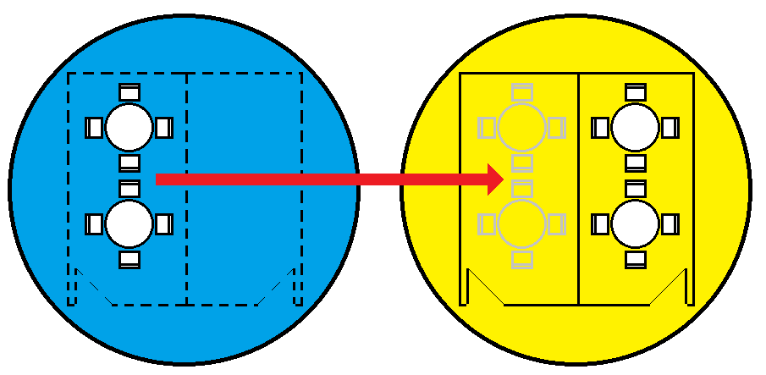
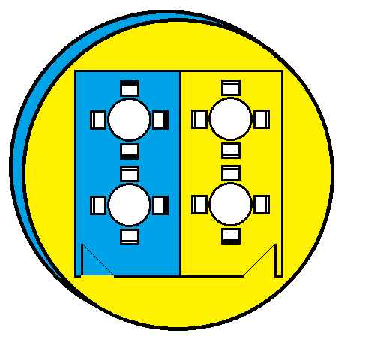
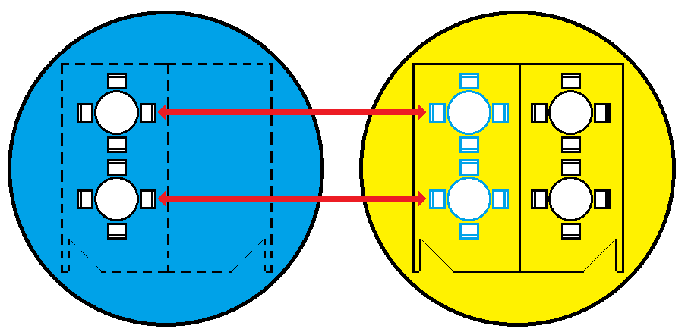
Three ways of working together
Import | Federate | Link
Importing all, round-tripping, or only import information if it is intended to change, for example a site-survey. | use a sub-model as background (or ‘referenced’) from multiple sources for particular reasons, such as clash detection, or generating reports like COBie or schedules. | Joining two entities in searpate datasets because they are known to be the same, or because we know their relationship, typically using the Sematic Web, ’Linked Open Data’ so as to check and query and explore the resulting singular model.

Slide 5
2. The nature of IFC information exchanges and the particular issues geotechnical raises.

Slide 6
active Asset and Project management
Site
Zones
Floor/
Region
Space/ Location
Facility
Systems
Type
Specification
Component
Project
Work packages
Task Specification
Job
© 2016 AEC3 Ltd
© 2013 AEC3 Ltd

Slide 7
Any element has many aspects
Element
Identification
Applied Values
Quantities
Constituents
Parts
Shape
Functional measures
Cost Values
Service Life
Properties
Attributes
Environmental Impacts
Complex properties

Slide 8
Any element is a leaf on many different trees
Element
Adjacent elements
Space
Type / Style
System
Classifications
(position)
Building
Site
Project
Classifications
(absolute position)
System
...
...
(position)
Zone
Cost Item
Cost Item
Cost Schedule
Floor
Zone

Slide 9
BuildingSMART Infrastructure Room
IFC is an international Standard for data exchange in the construction industries. It forms a COMMON Data model and open file format.
BuildingSMART Infrastructure Room’s (InfraRoom) remit is to develop common principles for achieving process integration during the design, construction and maintenance phases of infrastructure development
The InfraRoom is running these projects in parallel and is planning a 2020 finish for IFC5

Slide 10
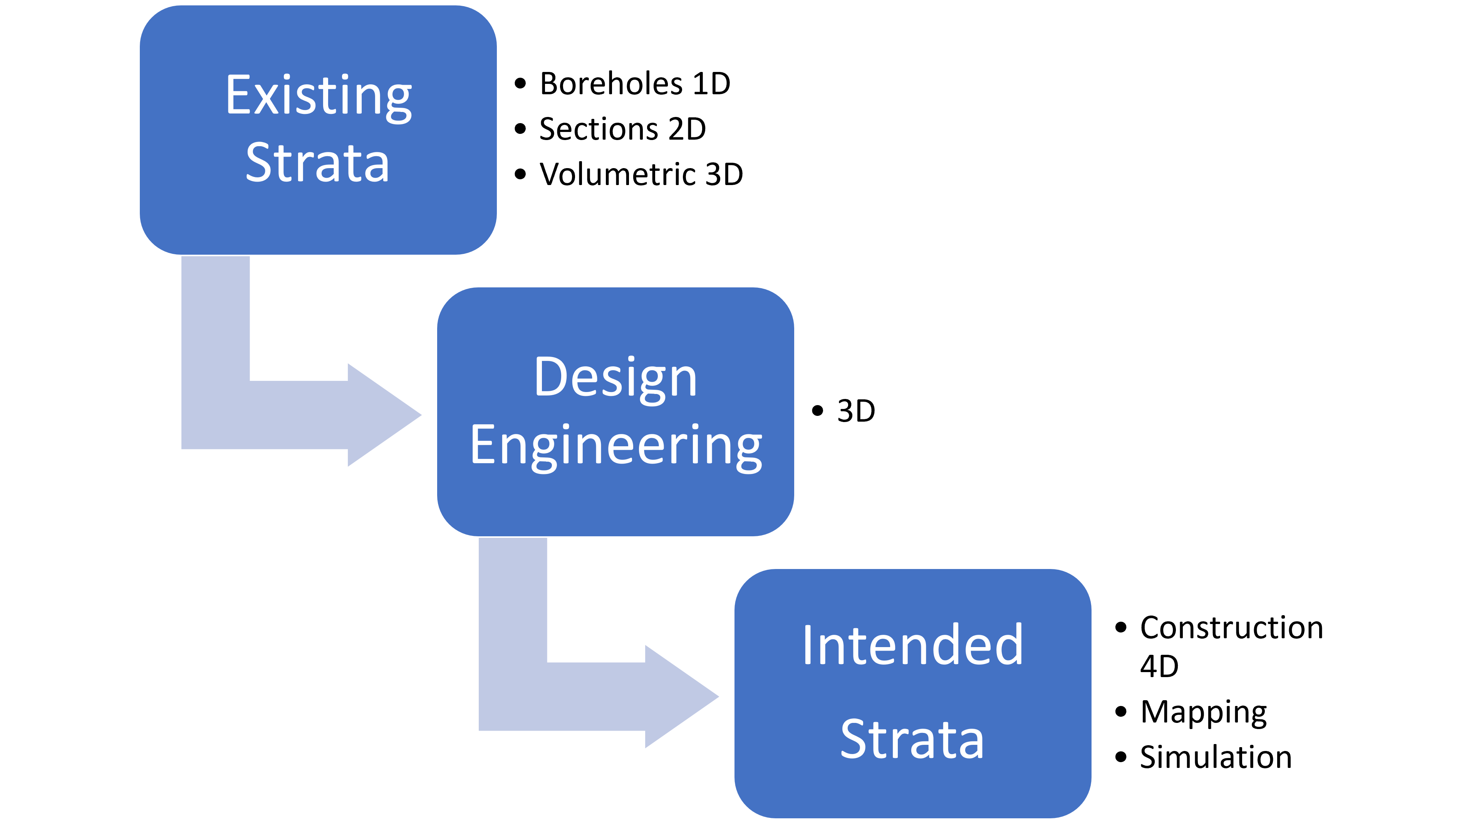
In scope
Except:
Earth & ground works proposal for strengthening and augmentation
Existing IFC eleents for Substructure such as piles, slabs and footings
Discrete point data and raster images
National and regional
Classification content
Attribute sets

Slide 11
IFC’s and geotechnical
Complete non-overlapping division into strata.
Separating solid strata and dynamic water strata ?
The top strata or topography
Clash-detection of structures against strata
Strata are artificial with varying properties and may be unbounded
Uncertainty and interpretation

Slide 12
3. The recommend approach and proposed solutions.

Slide 13
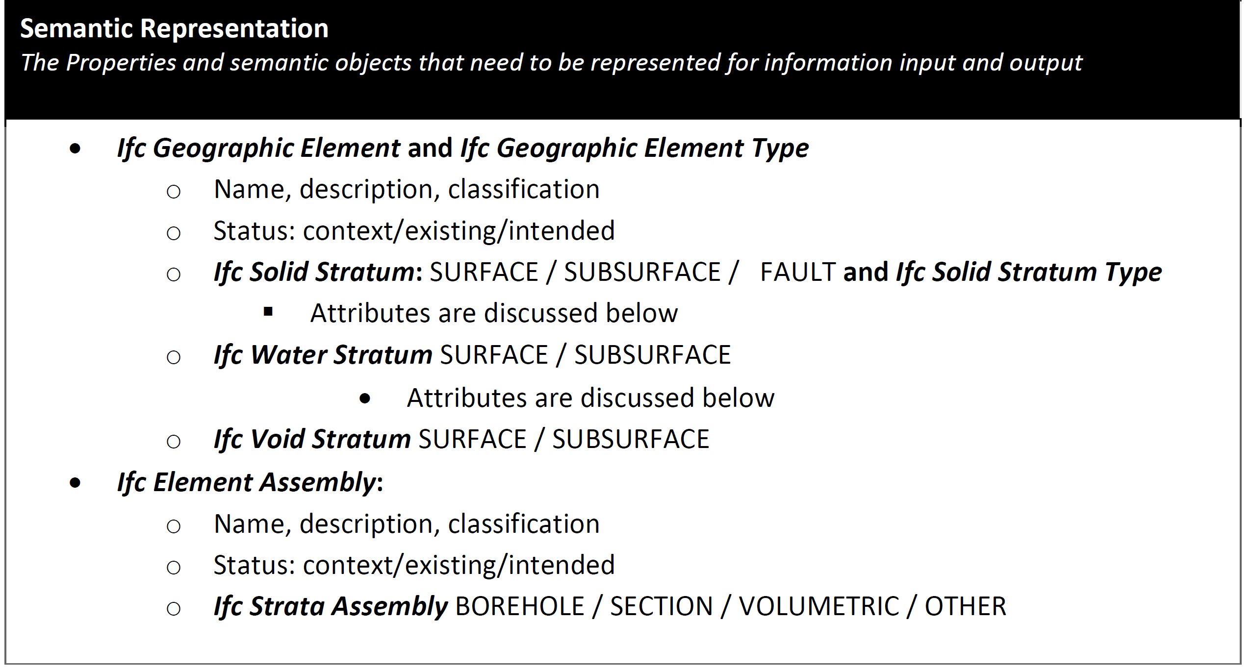
Semantic representation

Slide 14
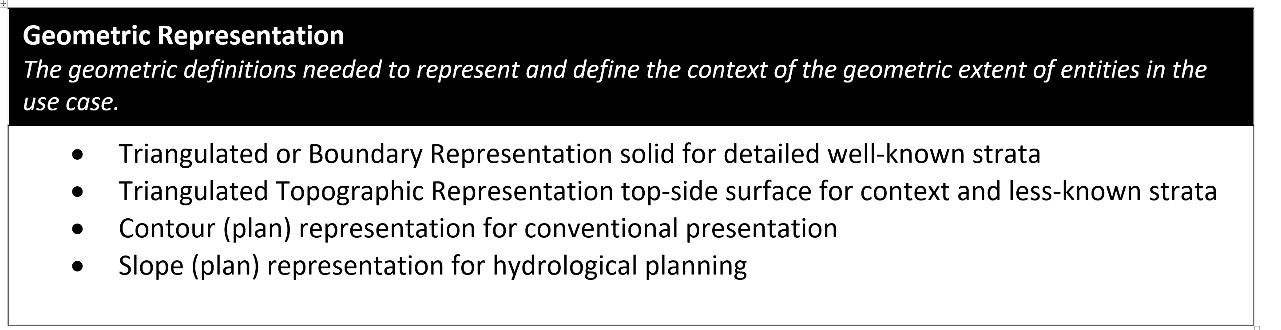
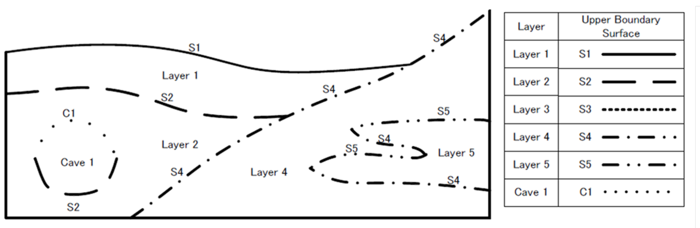
Geometric representation
Yabuki (top-side) representation:

Slide 15
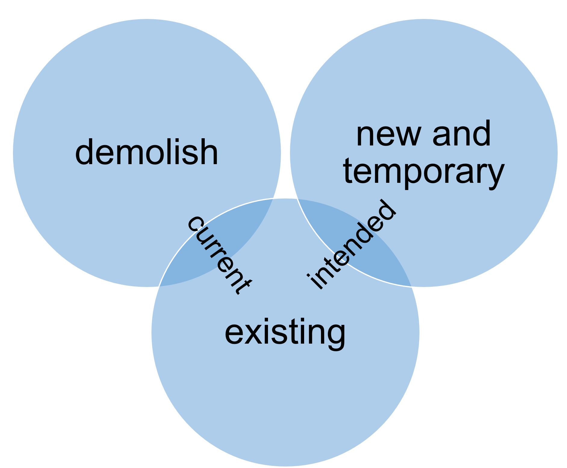
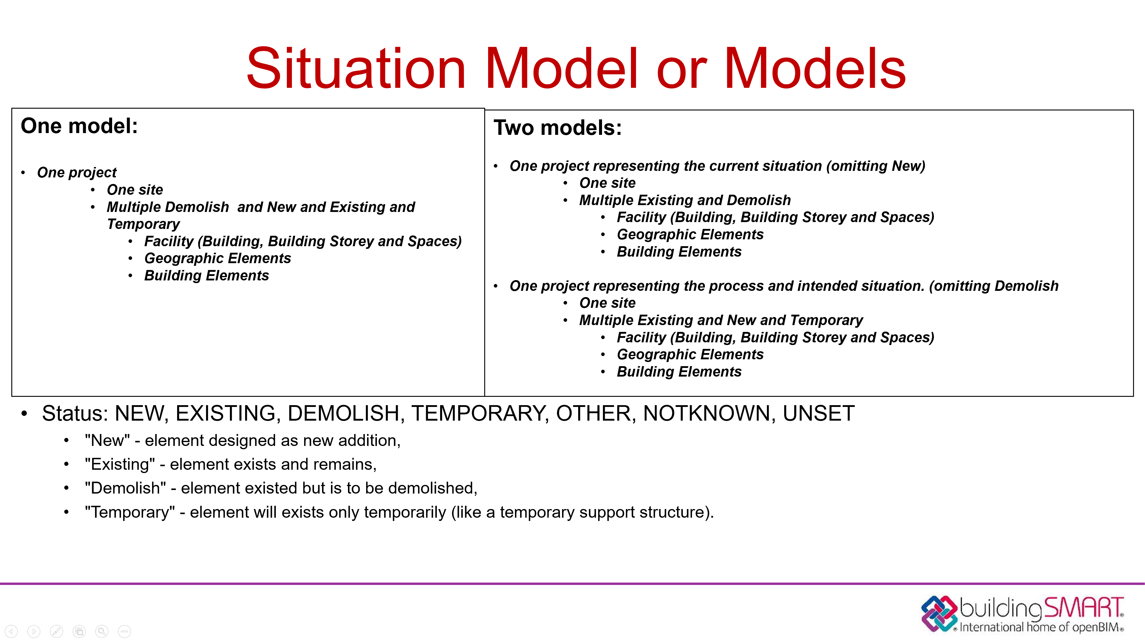

Slide 16
Attributes of a stratum or collection of strata
Name, description, type, classifications, owner, application, dates
Methodology, Status (phasing), Top/Other
Composition by volume and Analysis by mass
Capacity: loadbearing (pressure), settlement (length/vol), stability , permeability, cohesion, friction
Quantities:
plan area, top area, volume (3D)
plan length, top length, area (2D)
depth (1D)

Slide 17
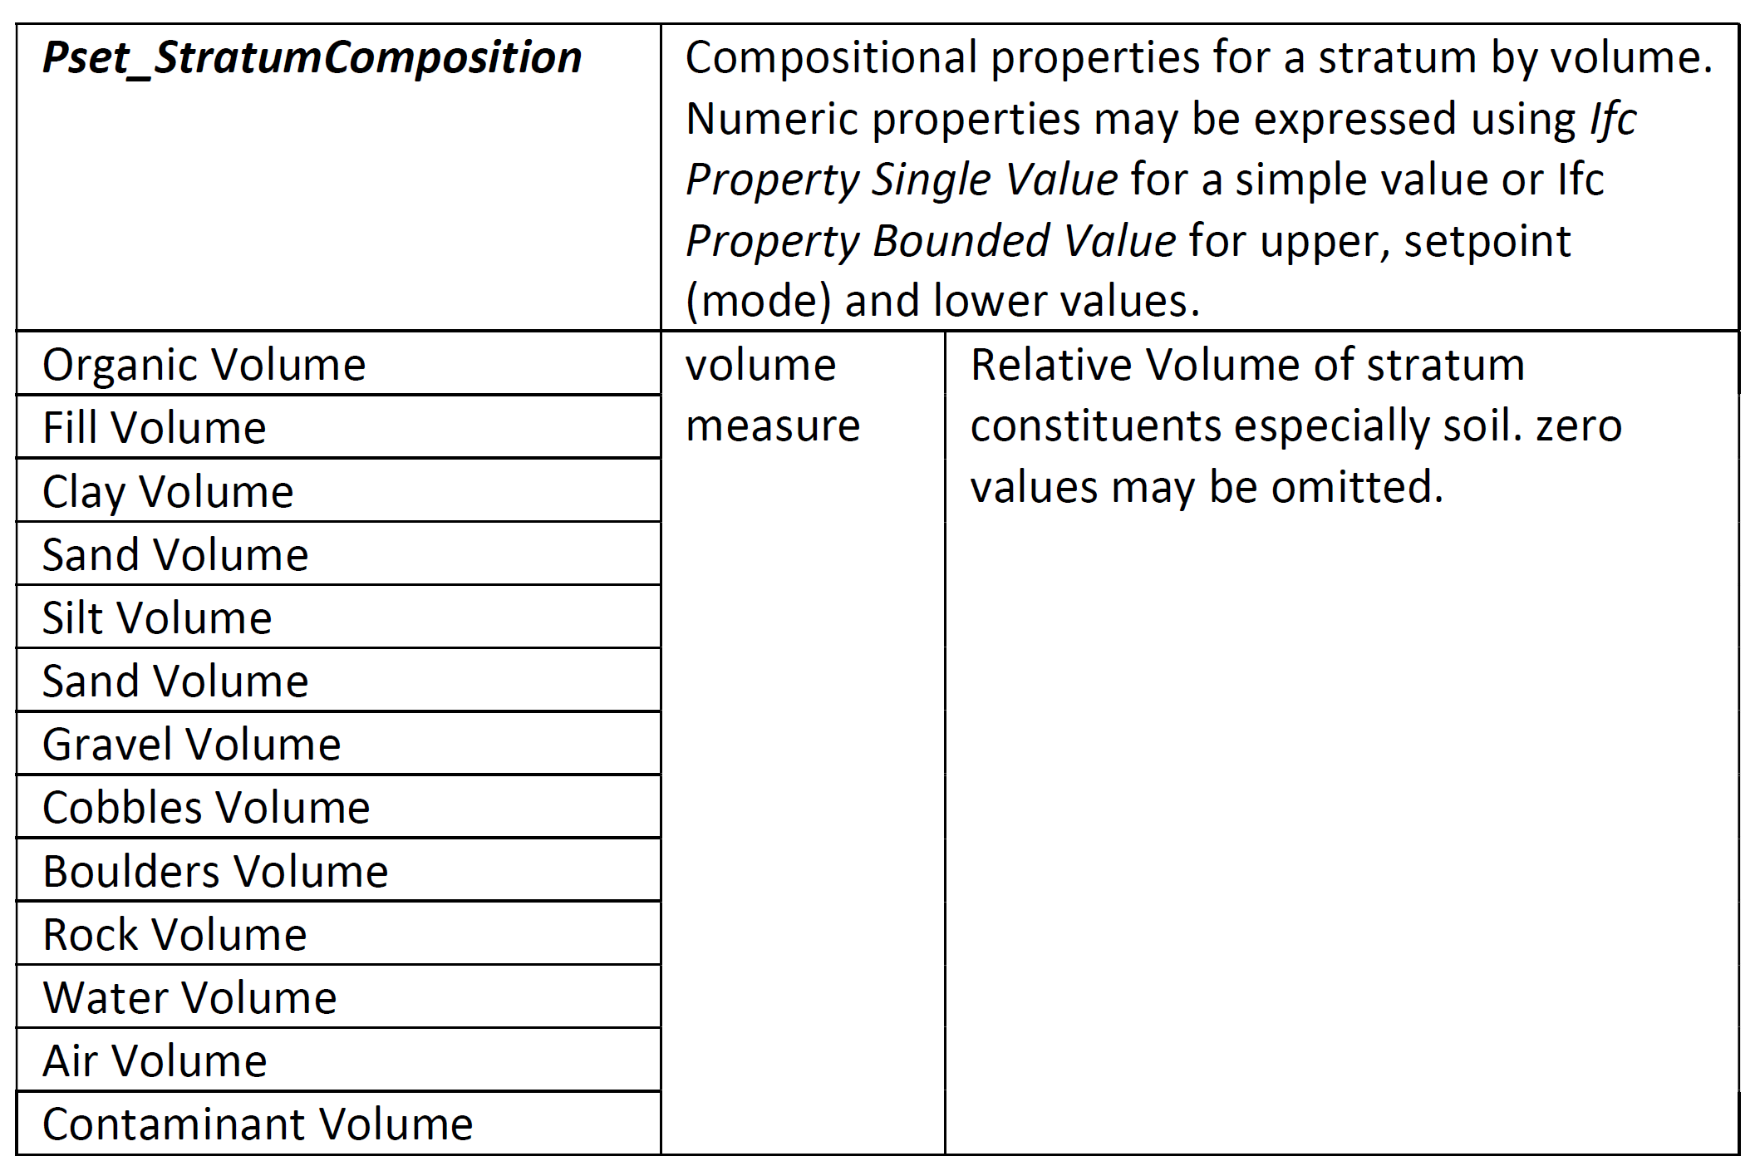
Composition

Slide 18
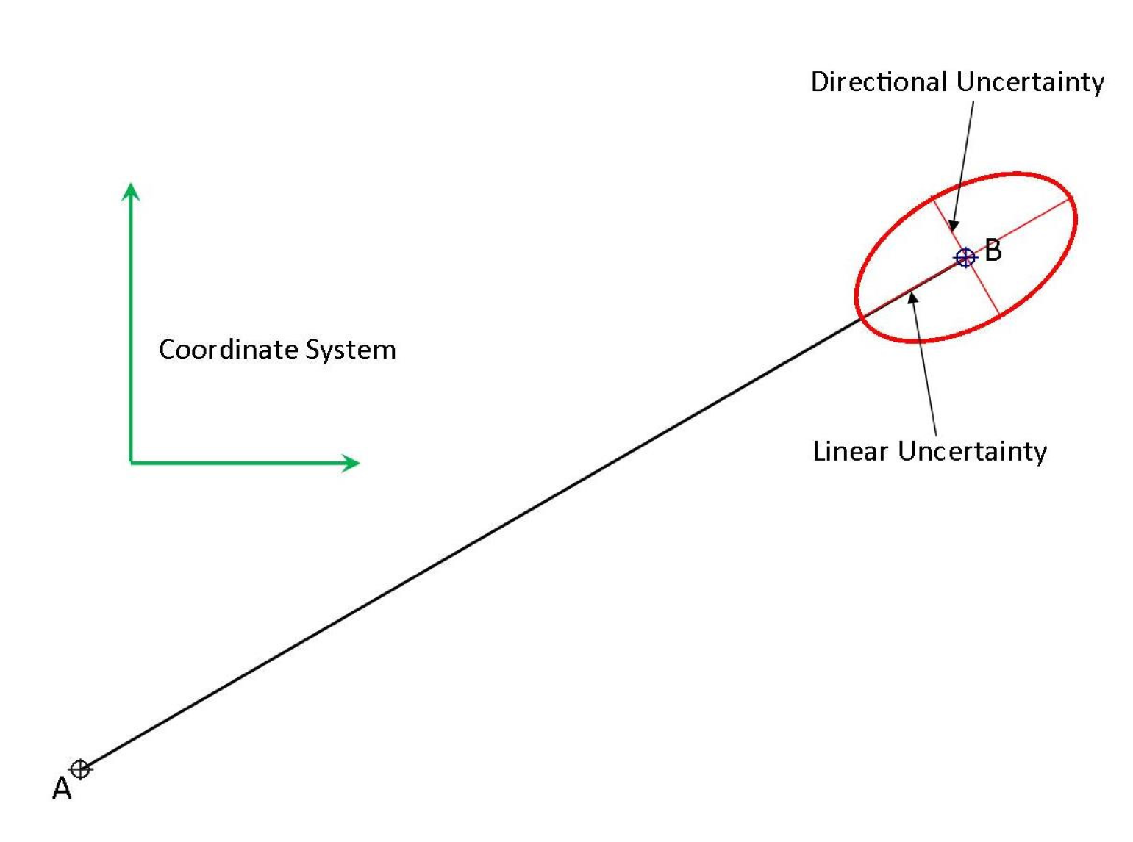
Shape and location uncertainty
Stratum
Entity with best estimate shape
Description of uncertainty
General linear uncertainty XYZ
Horizontal XY uncertainty
Orthogonal Y uncertainty
Vertical Z uncertainty

Slide 19
Attributes from other schemas except:
Existing such as name, description, owner history
Representing other constituent entities
National and regional classifications and assessments
Superseded by representation.
Legal and technical availability pre-requisite for collaborative coordination
Process details and history not relevant to collaborative coordination

Slide 20
Thank you. Any questions ? nn@aec3.com
Notes:
Dubai Waterfront.
NB The slides have ICC on the footer banner.

